Slide 1
Risk Assessment Project
Trader's Joe

Slide 2
Company Profile
An American chain of grocery stores based in Monrovia, California
Trader Joe’s began as a convenience store .
Migrated to a more novel design for adventurous food and beverage shoppers.
Company has 474 stores nationwide in 43 states and in Washington, D.C. with revenue of more than $13 billion.
C.E.O is Dane Bane (since 2001-
The company offer a wide array of products that are distinct from those sold in other food stores.
Notes:
Started in 1967 by Joe Coulombe, Trader Joe’s began as a convenience store but quickly migrated to a more novel design for adventurous food and beverage shoppers. TJ was comprised of 17 stores in the southern California area. By the early 1980s additional food products were introduced as the number of stores grew to 26. In 1988 they expanded to northern California. The combination of innovative products along with a service-oriented culture has created a loyal customer base that continues to grow nationally. Today, TJ has 474 stores in 43 states with revenues exceeding $13 billion.

Slide 3
Risk Identification
ERM posits that risk should be considered as anything that disrupts the status quo of a company.
Trader Joe’s is at risk of losing customers to Whole Foods and Amazon.
This is a strategic risk in its reliance on customer loyalty.
The company’s customers "cross shop" at both Whole Foods and Amazon at more than three times the industry average.
Trader’s Joe has built considerable customer loyalty around its unique products.
But this could potentially erode for Whole Foods under its increasingly centralized buying structure.
Notes:
ERM posits that risk should be considered as anything that disrupts the status quo, which means that there can be both negative and positive outcomes.”
Trader Joe’s is the retailer most at risk of losing customers to Whole Foods and Amazon, according to data from research firm Magid. This is because Trader Joe's customers "cross shop" at both Whole Foods and Amazon at more than three times the industry average.
Recent data from location firm Thasos shows that Trader Joe’s saw the highest rate of defection (10%) during Whole Foods' first week under Amazon (Wells, 2017).
many Trader Joe’s consumers were once Whole Foods consumers who migrated due to pricing or convenience,

Slide 4
Risk Assessment
Data indicates that Trader Joe’s saw the highest rate of defection (10%) during Whole Foods' first week under Amazon.
Such customer defection will translate to over $1.3 billion in revenues.
Now Whole Foods strategizes on providing premium goods that are natural and organic.
Price is also a key determining factor that may cause the defection.
Trader Joe’s offers low-priced private label brands.
but Amazon seems poised to lower the Whole Foods' prices overall.
Notes:
Recent data from location firm Thasos shows that Trader Joe’s saw the highest rate of defection (10%) during Whole Foods' first week under Amazon.
Price seems to be a key determining factor. Trader Joe’s offers low-priced private label brands, but Amazon seems poised to lower the Whole Foods' prices overall (Wells, 2017).

Slide 5
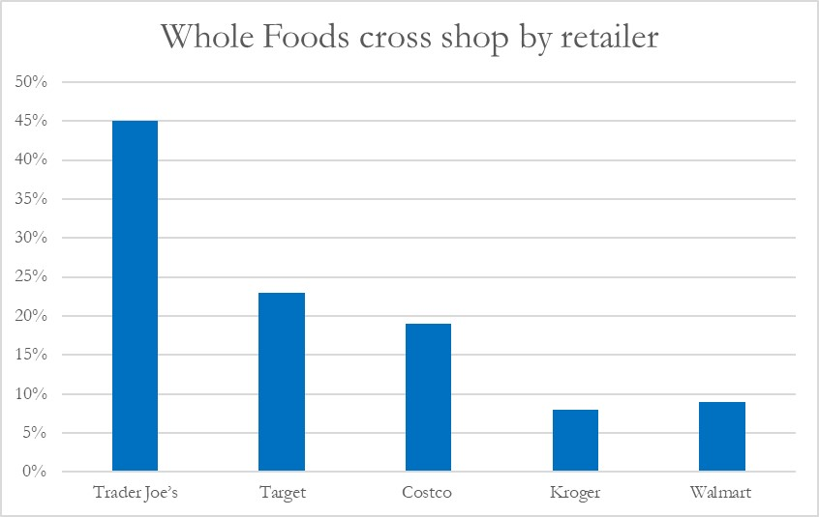
Risk Assessment Cont…
Notes:
The figure shows that the 45% of customers cross shop at Whole Foods.

Slide 6
Risk Assessment Cont…
Limited product selection in Trader’s Joe contribute to the cross shopping.
The company has around 3,500 SKUs (stock keeping units) at one time in its stores.
Average grocery stores have over 55,000 SKUs.
The buyer power is high in the company.
Their dependency on customers’ loyalty indicates that the company must continue to satisfy them if the relationship is to last.
Any significant customer loss will affect the operations and the financial statements of the company.
Notes:
Whole Foods' premium product assortment could be another lure. Both retailers are known for their selection of unique products, with Trader Joe’s boasting the more eccentric, experience-focused lineup compared to Whole Foods’ many values-driven brands. The grocers have also built considerable customer loyalty around their unique products, but this could potentially erode for Whole Foods under its increasingly centralized buying structure (Wells, 2017).

Slide 7
Risk Assessment Cont…
Company relies on sales volume rather than price of the products at the shelves.
Revenues are crucial for the planning and budgeting in the company.
Reduction in the revenues will force budgeting constraints.
Investment on workers will be affected.
Consequently, the efficiency of the company’s operations will drop.
Therefore to maintain the revenues and profit margin, the company must work to maintain its clientele.
It must also seek to devise risk mitigation strategies to counter the moves taken by its competitors.
Notes:
Company relies on sales volume rather than price of the products at the shelves. Revenues are crucial for the planning and budgeting in the company. Reduction in the revenues will force budgeting constraints. Investment on workers will be affected. Consequently, the efficiency of the company’s operations will drop. Therefore to maintain the revenues and profit margin, the company must work to maintain its clientele. It must also seek to devise risk mitigation strategies to counter the moves taken by its competitors.

Slide 8
Risk Management Plan
In managing the risk of customer loss to competitors, the company may choose to either control or finance the risk.
In controlling the risk, it must take measures physically and procedurally to prevent or reduce the customer defection and its impact.
In financing the risk, it may purchase an insurance to cover for the impact of the risk.
It may also choose to create a captive insurance company or execute a contractual transfer of the risk.
The last strategy is to retain the risk through in-house financing.
Notes:
In the context of ERM, the decisions made on the choices of techniques will be made by those most likely to manage the risk, as opposed to just the risk manager and risk management staff members. In managing the risk of customer loss to competitors, the company may choose to either control or finance the risk. In controlling the risk, it must take measures physically and procedurally to prevent or reduce the customer defection and its impact. In financing the risk, it may purchase an insurance to cover for the impact of the risk. It may also choose to create a captive insurance company or execute a contractual transfer of the risk. The last strategy is to retain the risk through in-house financing.

Slide 9
Risk Management Plan Cont…
The ERM process requires open communication and transparency in how risks are managed and risk-based decisions made.
Therefore, the company ought to be clear with its employees on the risk mitigation strategy it chooses to use.
In this case of customer loss, controlling the risk would be the appropriate strategy.
It will address the key issues making the customers to cross shop.
With Amazon strategizing to lower the price of Whole Foods products, price can no longer be a competitive advantage for Trader’s Joe.
Notes:
The ERM process is one that requires open communication and transparency in how risks are managed and risk-based decisions made. The mismanagement of risk can carry an enormous price—considerable financial loss, decreased shareholder value, damaged company reputation, dismissal of senior management, and in some cases the destruction of the business(McEwan, 2017).

Slide 10
Risk Management Plan Cont…
The company will increase the product selection in its stores.
This will make it unnecessary for its loyal customers to cross shop in its competitors stores.
Business Continuity will be a crucial part of the risk management process.
The BCP represents the commitment to response, resumption, recovery, and restoration planning.
Notes:
The company will increase the product selection in its stores. This will make it unnecessary for its loyal customers to cross shop in its competitors stores. The BCP represents the commitment to response, resumption, recovery, and restoration planning.
The Business Continuity Program and Plan (BCP) is a critical part of the Enterprise Risk Management program. Developing a BCP is a structured process and results in a manual that is used to respond to events that are of utmost concern to organizational leaders, i.e., events that can disrupt the business.
The BCP represents the commitment to response, resumption, recovery, and restoration planning. This plan must be kept current to ensure the accuracy of its contents. Each individual responsible for information or materials in the document must ensure that resources are committed to the maintenance of its contents (McEwan, 2017).

Slide 11
Business Continuity Plan Worksheet
Purpose: To Create An Action Plan To Mitigate The Critical Risks Assessed And Establish The Basis For Training And Drills.
Risk: Loss of customers to competitors
Rank: High
Risk Assessment Critical Areas: Economic-Financial, Reputation& Confidence in the company, Operational Service.
Business Impact Analysis Critical Functions: Customer Service, Finance

Slide 12
Business Continuity Plan Worksheet Cont…
Description Of How This Risk Will Impact The Company:
    Reduction in profitability
    Over-capacity of assets/vessels
Outline The Plan Steps In Detail That Will Be Followed To Mitigate The Risk:
    Preventative:
      Maintain existing customer by increasing product selection.
      Continually grow customer base
  Mitigation 1: increase sales from the remaining customer(s)
  Mitigation 2: File with PUC for a Rate Increase.
  Mitigation 3: Restructure Tariff (Rules & Rates), including increasing /adding discounts, certain lines of services,
  Trigger for mitigation: 10% customer defection.

Slide 13
Business Continuity Plan Worksheet Cont…
3. The Responsible Persons Who Will Oversee The Execution Of The Mitigation Plan: C.E.O. and branch managers.
4. Additional Resources Needed To Successfully Mitigate The Risk:
Supplies Needed- more diverse stock to facilitate product selection.
Personnel Needed- more employees to support on sales
Cost Estimate- extra cost in marketing and stock purchase.
Equipment Needed- N/A

Slide 14
Business Continuity Plan Worksheet Cont…
5. Timeline For Mitigation Actions:
  For Mitigation 1: Ongoing.
  For Mitigation 2: To be determined.
      For Mitigation 3: At least One (1) Year for PUC Application
    6. Metrics That Will Determine The Success Of The Plan:
      For Mitigation 1: successfully maintain the company sales
      For Mitigation 2: Rate of Return improves, No loss of “goodwill” with PUC
      For Mitigation 3: productively apply Restructured Tariff

Slide 15
Business Continuity Plan Worksheet Cont…
7. Contingency If This Plan Isn’t Successful
Change the business model- adopt marketing strategies
                -competitive advertising
                -comparative advertising.
Notes:
Developing the BCP is an excellent way to get managers involved in the risk assessment process and in making decisions that are needed in the ERM process (McEwan, 2017).

Slide 16
Summary
Trader’s Joe is one of the biggest grocery retailers in America and across the globe.
Despite that, it faces risk of customer loss to its competitors.
Enterprise risk management provide the mechanism to handle such risks.
Through development of a business continuity plan (BCP).
The BCP represents the commitment to response, resumption, recovery, and restoration planning.
Notes:
Trader’s Joe is one of the biggest grocery retailers in America and across the globe. Despite that, it faces risk of customer loss to its competitors. Enterprise risk management provide the mechanism to handle such risks. Through development of a business continuity plan (BCP). The BCP represents the commitment to response, resumption, recovery, and restoration planning.

Slide 17
References
McEwan, B. (2017). Enterprise risk management: from Theory To Practice. John Wiley & Sons.
Parker, B. (2016). 9 Ways to Save Major Money at Trader Joe’s. Popsugar Inc.
Weinstein, A. T., Levy, E., Ligonde, B., Orjuela, J., Rafique, Z., & Salgado, D. (2015). Trader Joe's-A Customer Value Case Study.
Wells, J. (2017). “Trader Joe's could lose more customers than any other store to Amazon-Whole Foods”. Grocery Dive. Retrieved from https://www.grocerydive.com/news/grocery--trader-joes-could-lose-more-customers-than-any-other-store-to-amazon-whole-/534609/

